Slide 1
THE RAPID-START
ENTERPRISE
SERVICE DESK
Create and deploy service desks instances in less than 60 seconds

Slide 2
Every enterprise has several
service teams that are just like IT
Travel
Legal
Human resources
Finance
Facilities

Slide 3
But they have differences
in service delivery
Reference frameworks and standards like ITIL, COBIT, ISO/ICE 2000
Emphasis on self-service
Automated processes and workflows
Metrics-driven visibility and insights into operations and customer experience
Technology adoption for service management functions
Service management in
IT teams
Service management in
non-IT teams

Slide 4
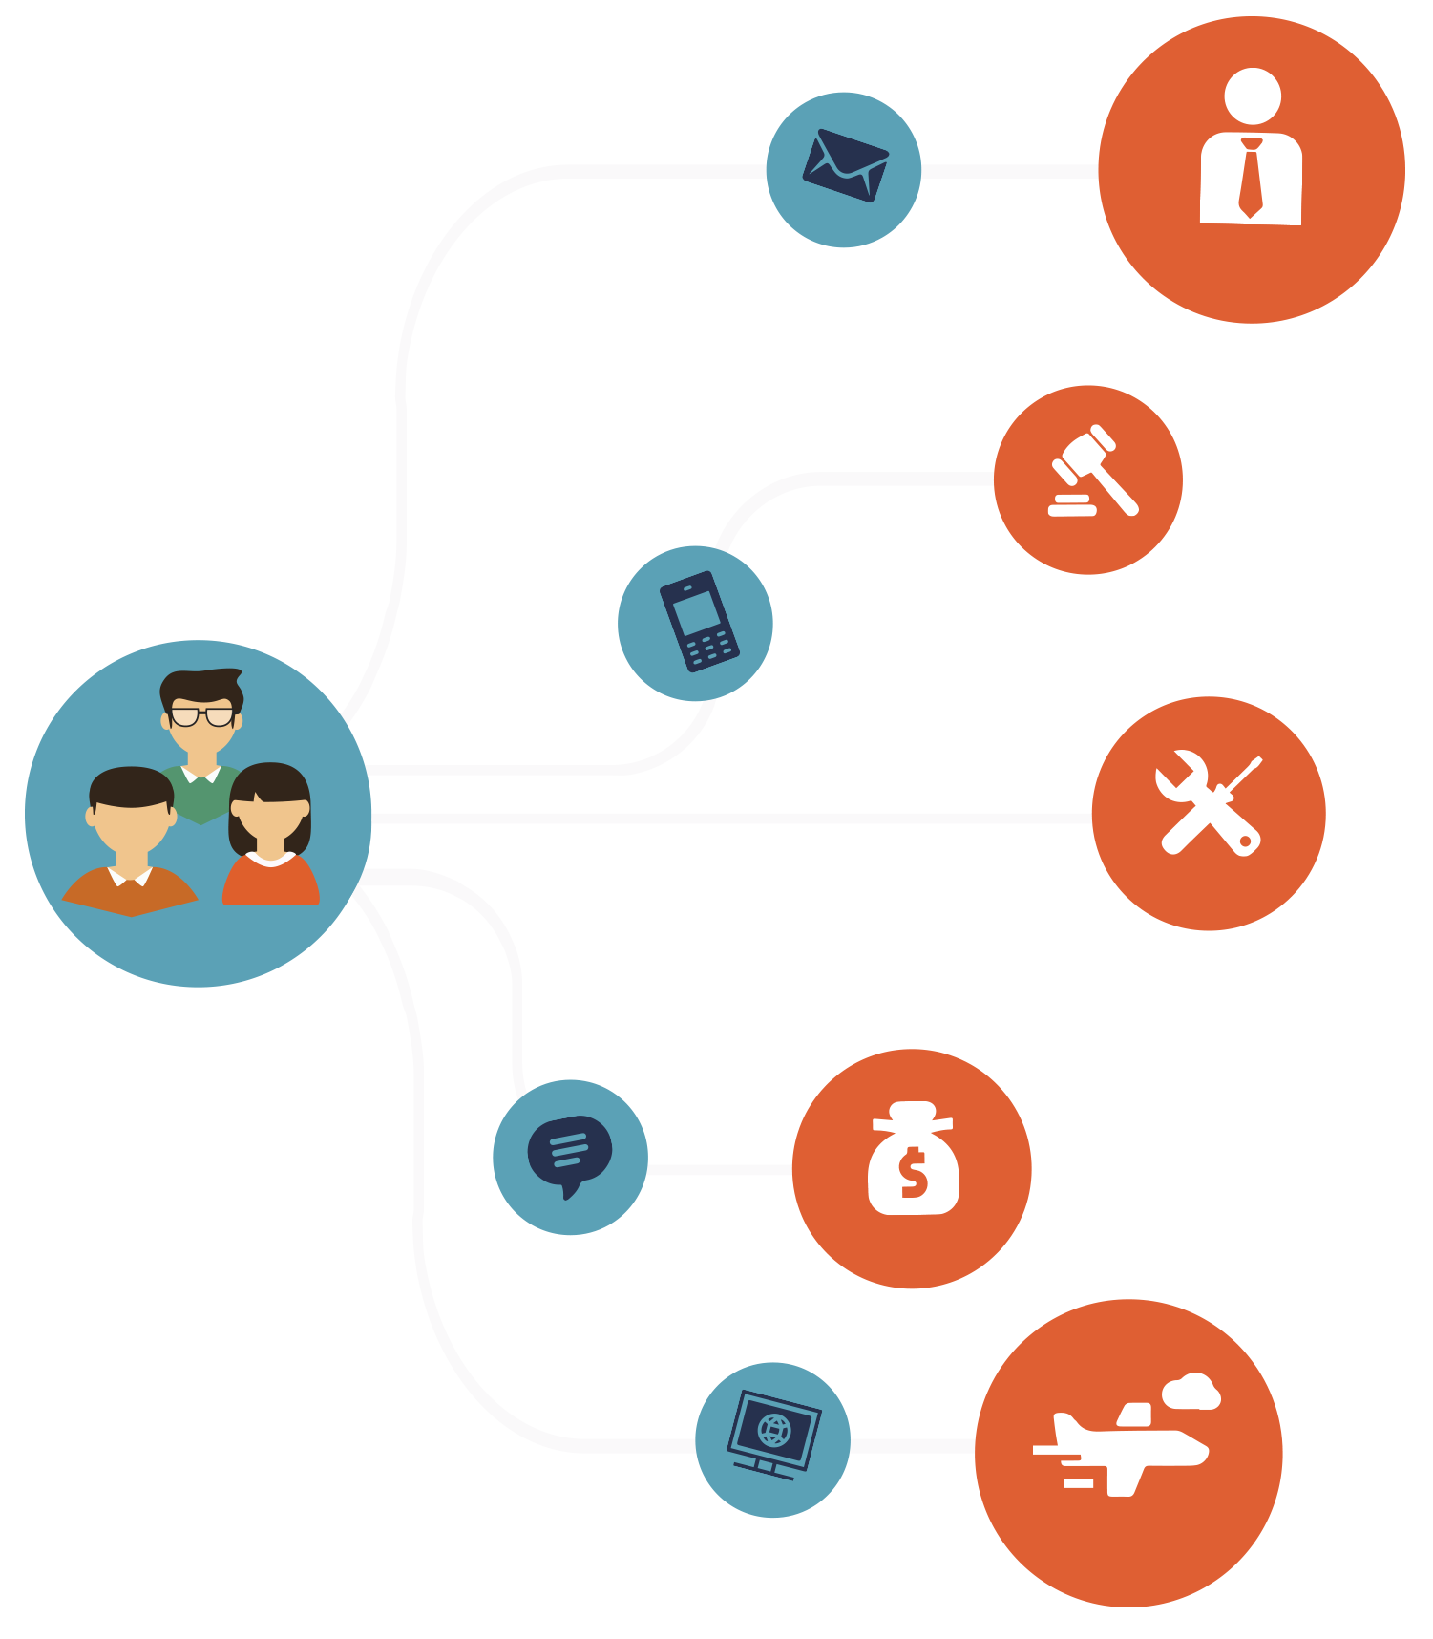
Because they look like this

Slide 5
And this leads to...
Lack of standardization
of services
across different business functions
Disparate and redundant tools reflecting underlying silos
Disjointed end-user experience by dealing with multiple teams and apps
The investments into IT process, tools, and best practices that benefit the IT team not being extended to other teams

Slide 6
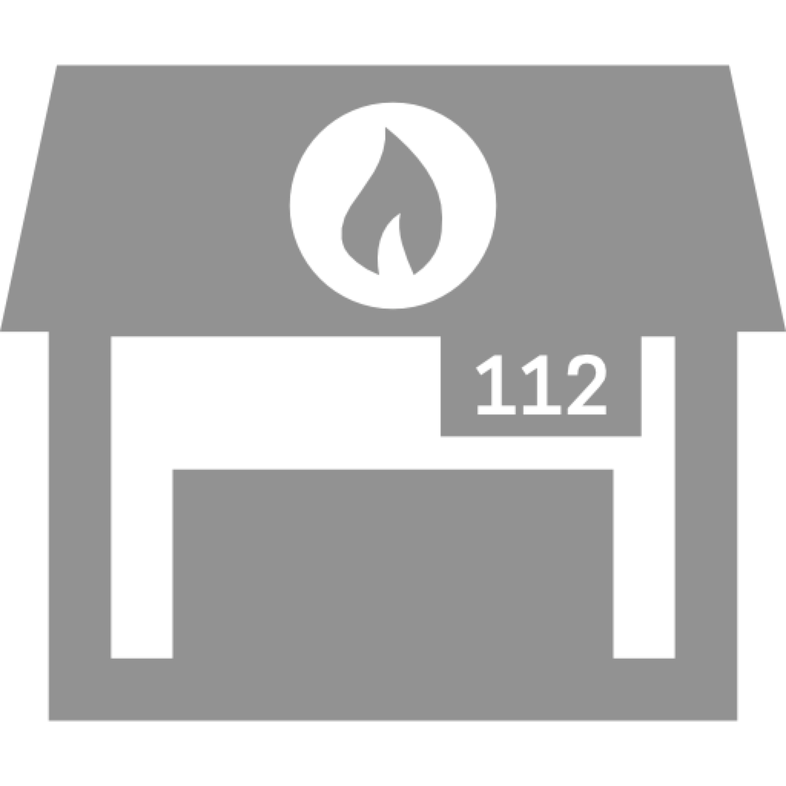
But why are they different?
A lot of operational efficiency problems in IT are solved with technology and process automation.
Unlike IT, technology adoption doesn't always take the front seat in other
business functions
Complex, costly, and cumbersome implementations can create another Big Dig situation
IT is so busy firefighting that strategic technology projects often take a back seat

Slide 7
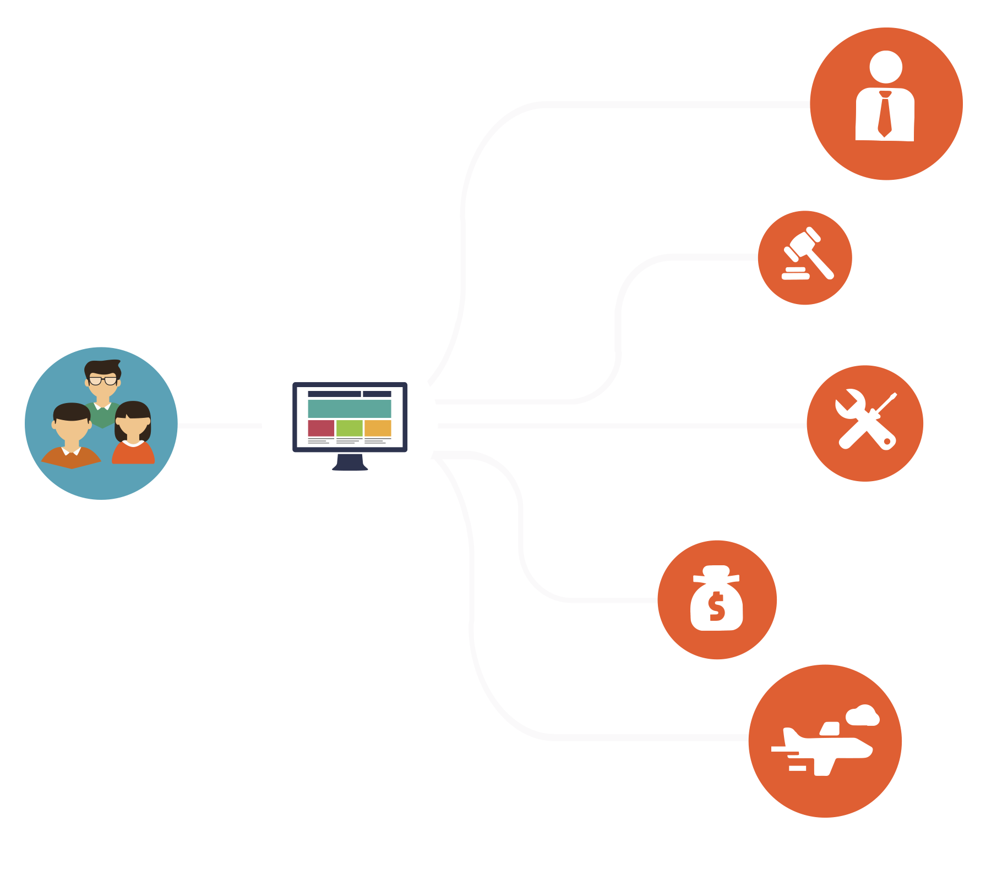
What if they weren't?

Slide 8
A central portal for end users to raise and track issues
A consistent end-user experience across service teams
Seamless
service management with a single tool across the enterprise
IT standards
and best practices extended to other service teams
This means
you get...

Slide 9
And the best way
to get there?
Leverage investments in IT to benefit other service management teams
Do that quickly and easily without overhead

Slide 10
Introducing the
RAPID-START ENTERPRISE SERVICE DESK
Built on the industry-leading,
flagship ITSM app ServiceDesk Plus;
used by over 100,000 service desks worldwide

Slide 11
The
Multiple
instances
RAPID-START ENTERPRISE SERVICE DESK
One
organization
One
portal

Slide 12
The
RAPID-START ENTERPRISE SERVICE DESK
Create and deploy service desk
instances in less than 60 seconds

Slide 13
Key features
Single enterprise directory
Unique service desk instances
Service
automation
Built-in catalog and
templates
Centralized request
portal

Slide 14
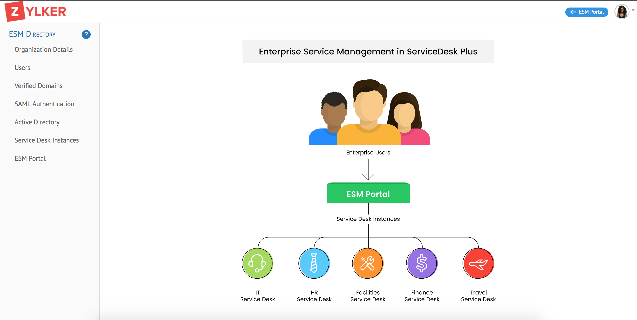
Single enterprise directory
Maintain users, service desks, authentications, and associations in one place.

Slide 15
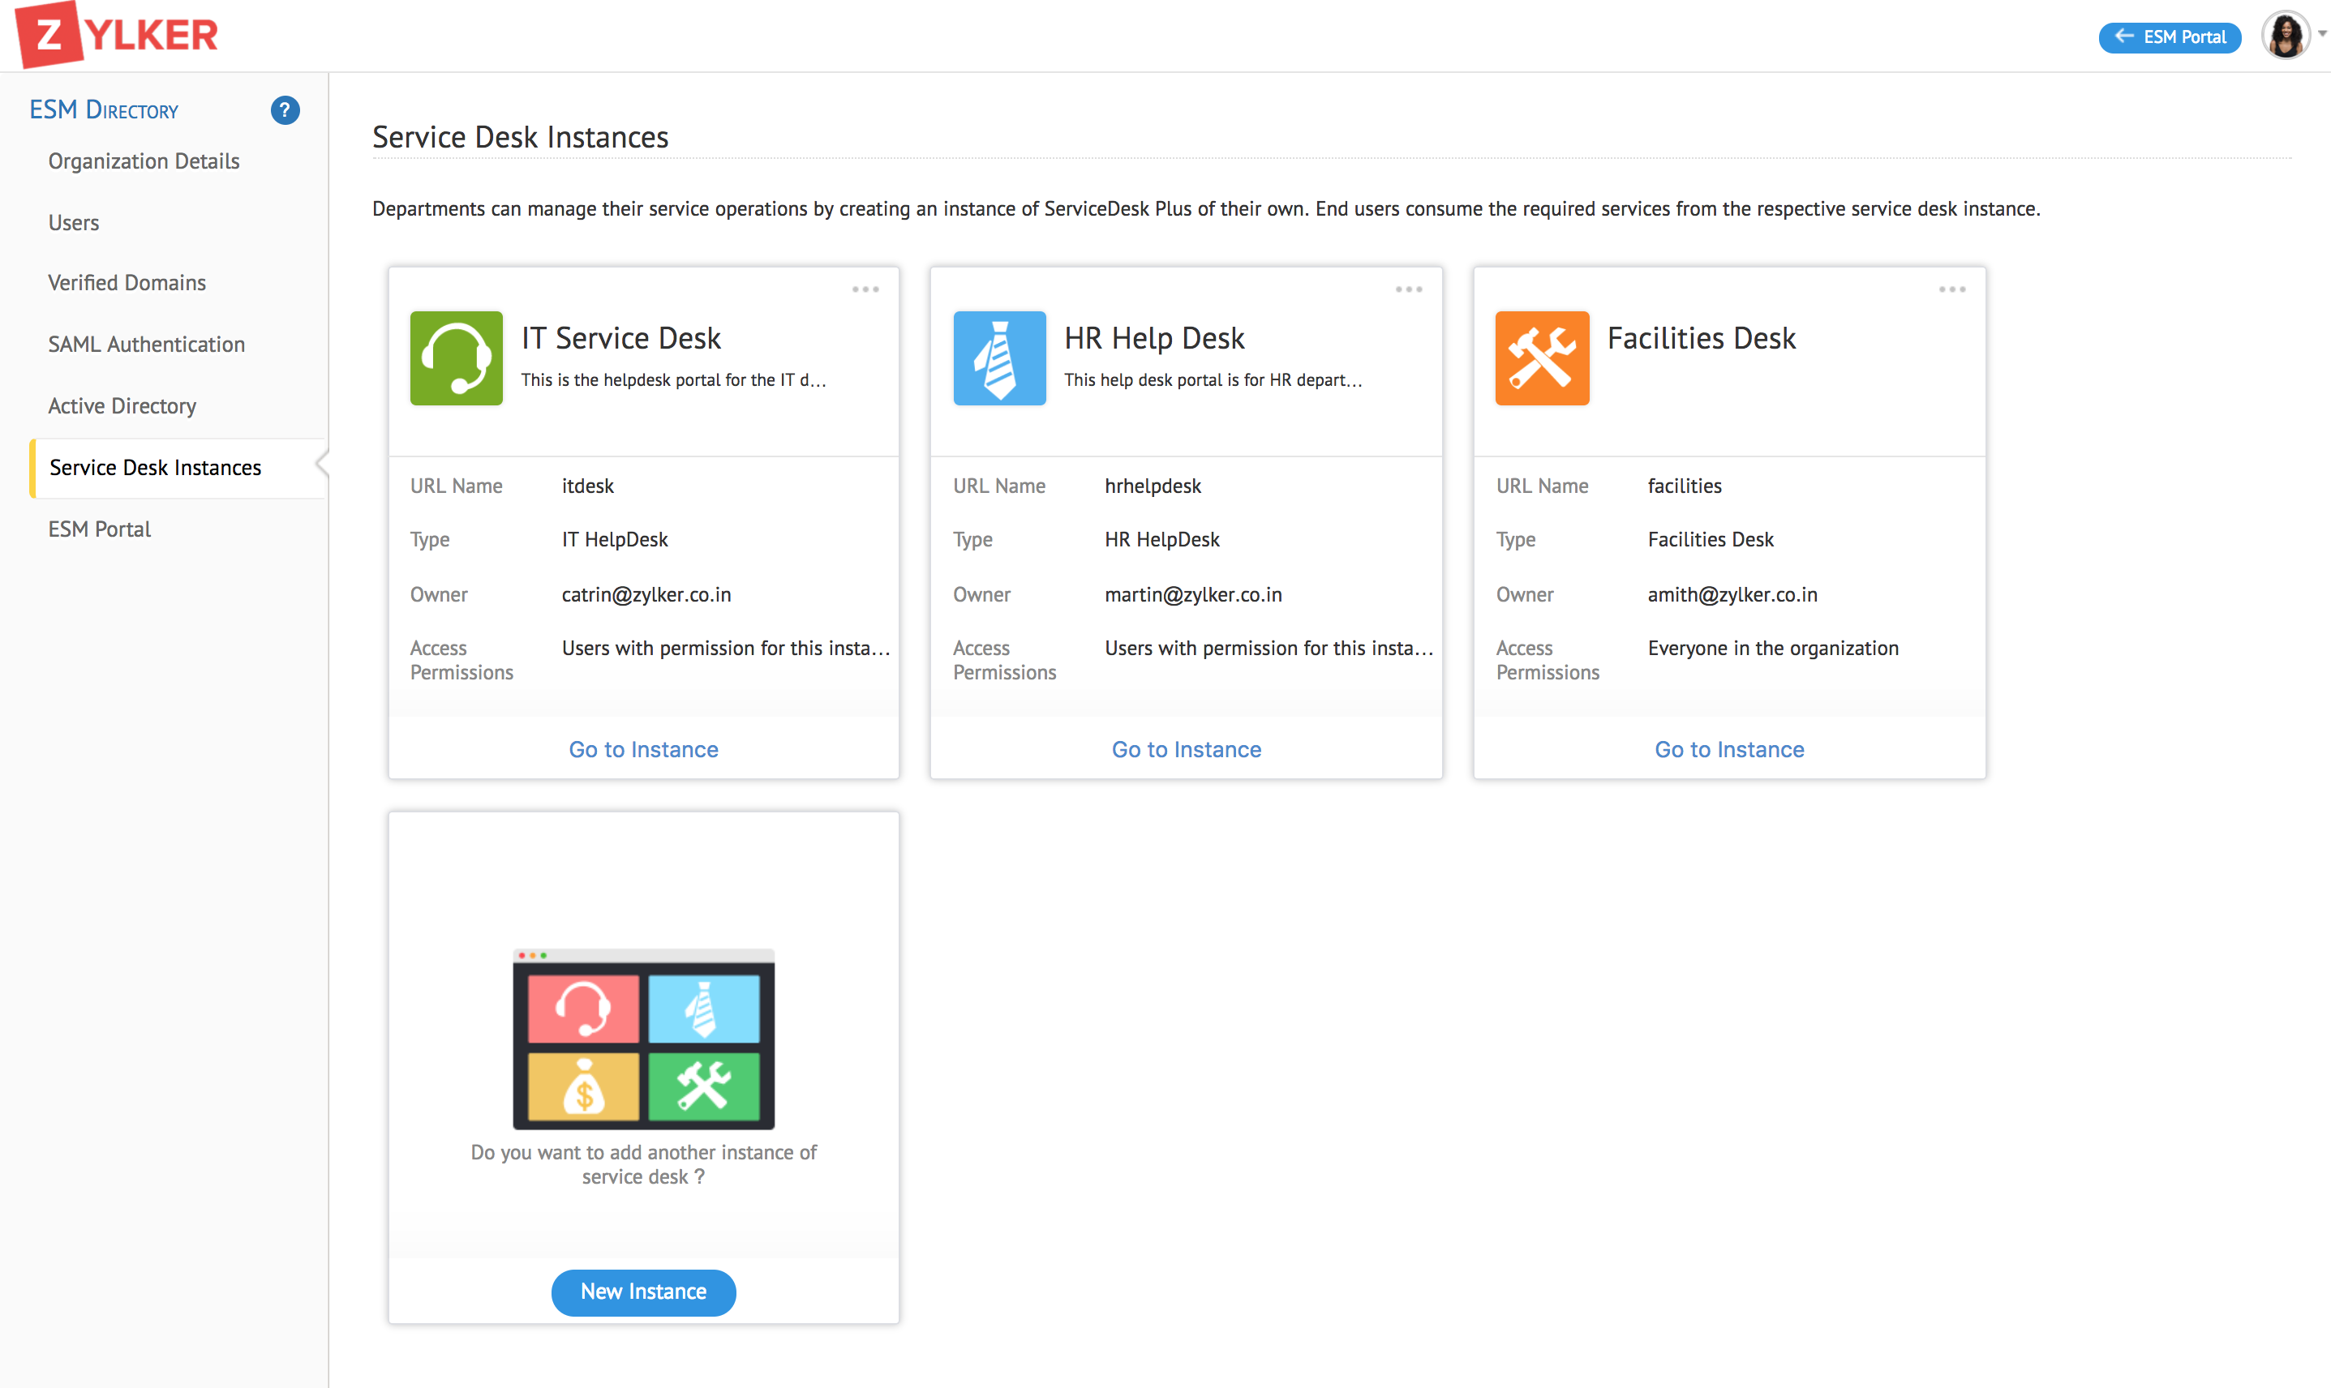
Unique service desk instances
Create separate service desk instances for each business function and facilitate organized service delivery using code-free customizations.

Slide 16
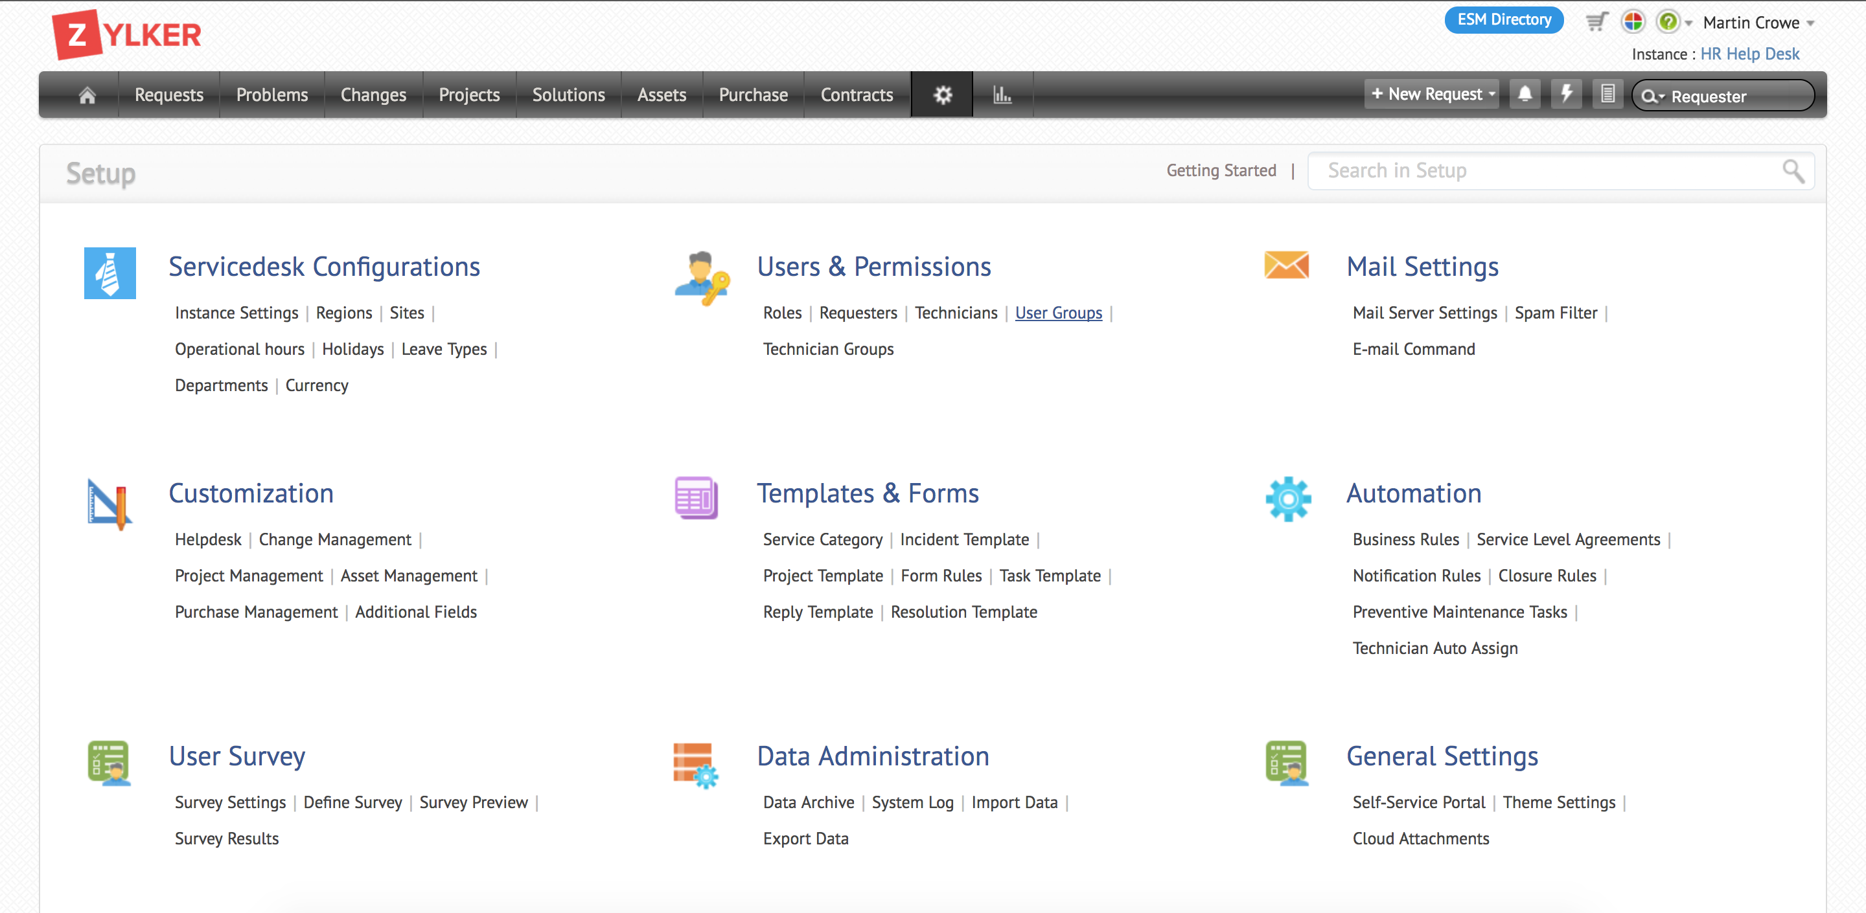
Service automation
Implement ITSM workflows to efficiently manage all aspects of the business service life cycle.

Slide 17
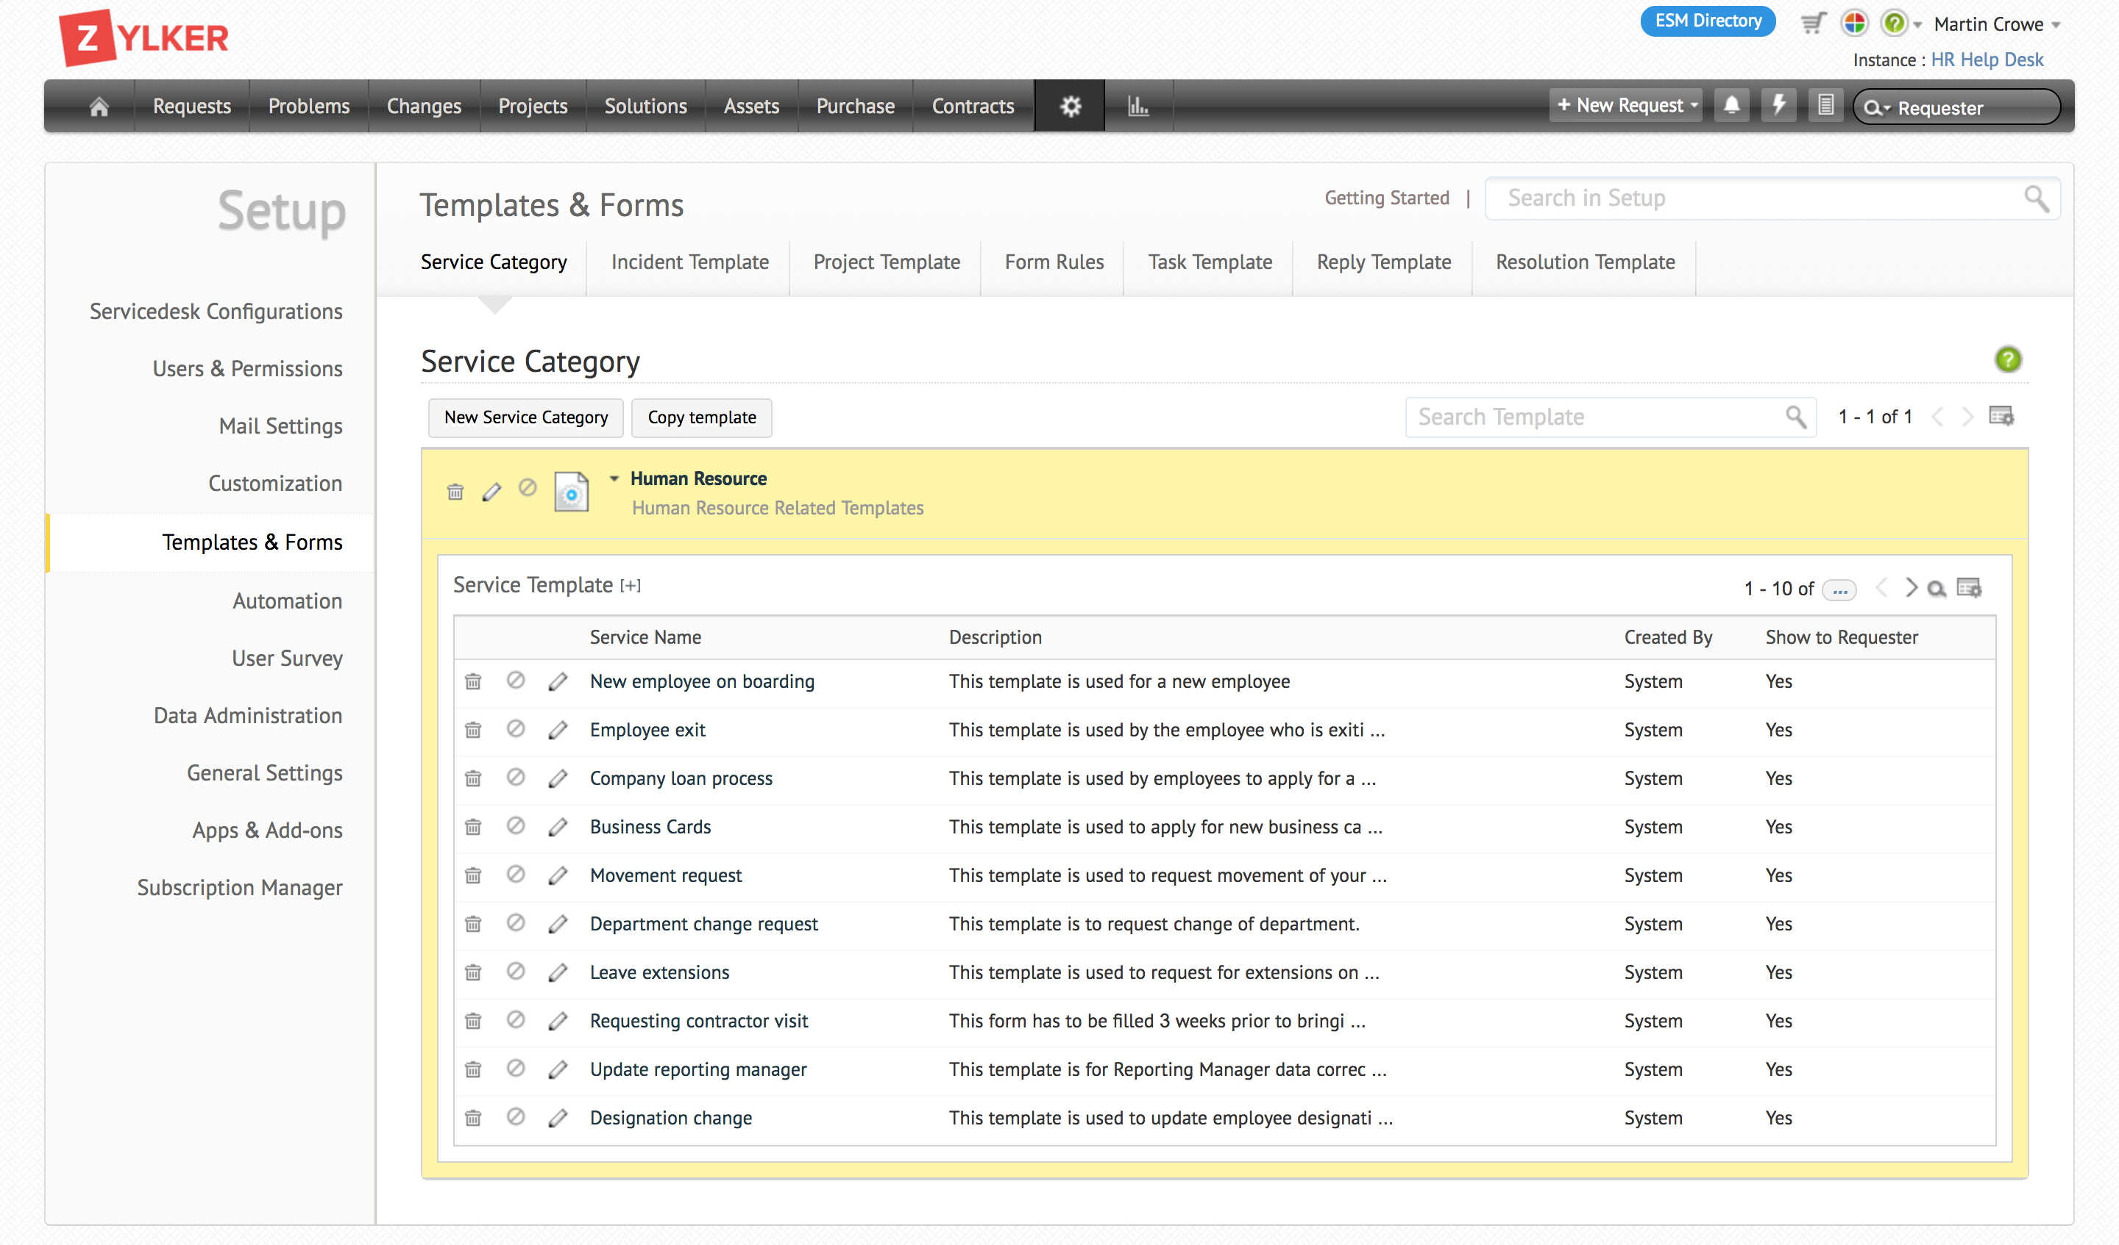
Built-in catalog and templates
Accelerate service management adoption across departments by using prebuilt templates and service catalogs unique to each business unit.

Slide 18
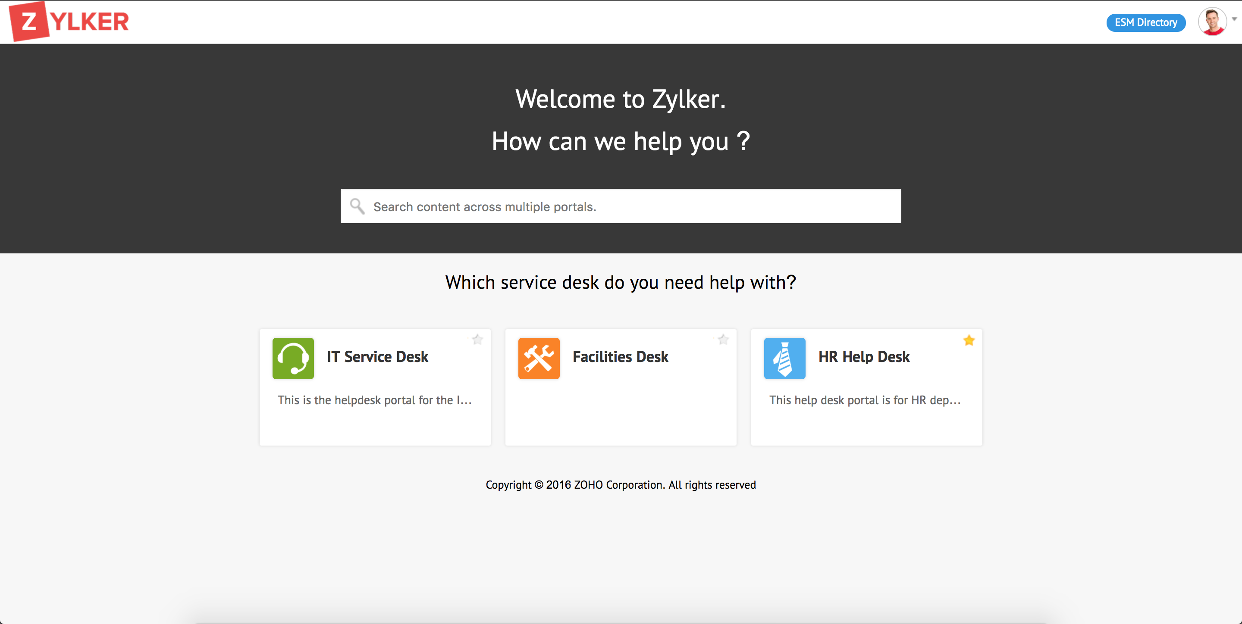
Centralized request portal
Showcase all the services that end users require using a single portal based on each individual's access permissions.

Slide 19
Unique features
Rapid start
Flexible
Centralized
Create and deploy a service desk instance in under 60 seconds.
Give end users a central portal for multiple service desk instances.
Choose between
any of the three ServiceDesk Plus editions for each instance and
switch between
editions as required.

Slide 20
Move tickets
between different
service desk instances
Third-party integrations unique to
specific domains (like HR, facilities,
etc.) for each type of instance
A full-fledged facilities
service desk instance with native terminology and modules
Roadmap

Slide 21
Having separate service desk instances for IT, facilities and records allows us to track the issues separately while giving us access to the other departments' resources. With the new version of ServiceDesk Plus, we feel like the firm's support and administration departments are working together to provide assistance. I love that it's customizable, easy to use and available at a great price.
Beverley Seche,
Network Administrator at Stark & Stark, Attorneys at Law.

Slide 22
Thank you
www.servicedeskplus.com
hello@servicedeskplus.com
me_itsm
facebook.com/servicedeskplus

