Slide 1
IT management, simplified.
Real-time IT management solutions for the new speed of business

Slide 2
Underpinning of a successful IT help desk
Asset management in
ServiceDesk Plus

Slide 3
Say hello to Zylker
BUSINESS USERS
IT FOLKS
SCOTT
IT TECHNICIAN
DAVE
HIRING MANAGER
JASON
IT TECHNICIAN
CIO
MARCUS
CATRIN
IT SERVICE MANAGER
ADAM
IT TECHNICIAN
WENDY
HR
JOHN
END USER

Slide 4
Zylker IT manages their assets
Asset management with ServiceDesk Plus

Slide 5
Zylker’s guessing game
The IT team guesses the number of existing licenses
Ooooh! We got MANY!
400?
So how many licenses do we have?
Definitely 100!
Around 500.
And who’s right?
None!

Slide 6
Asset management with ServiceDesk Plus
ServiceDesk Plus to the rescue!
A

Slide 7
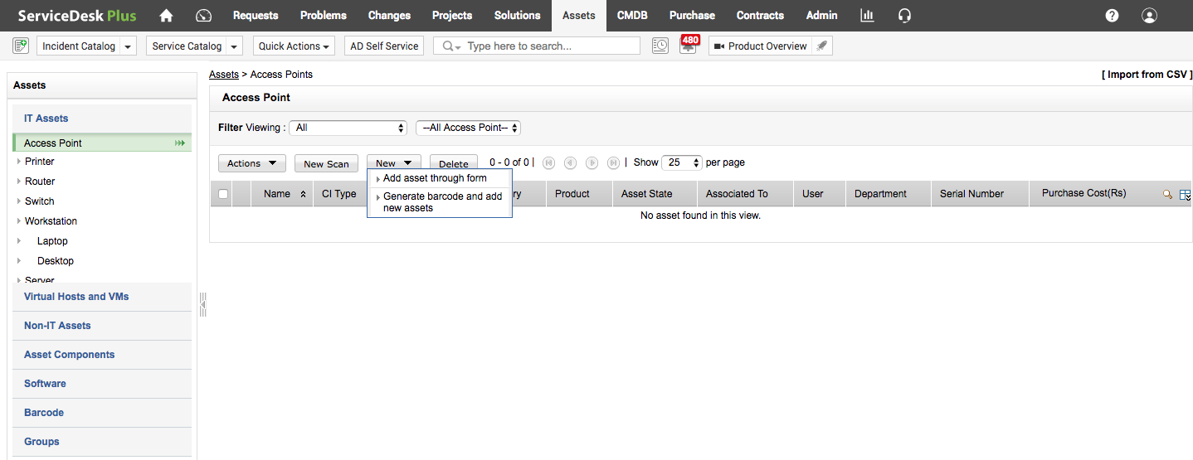
IMPORTING ASSETS
FEATURE: ASSETS
Zylker is a large organization with a large asset base. To manage all the assets in a common place, Catrin assigns technicians to add the assets to the application using the different options available in ServiceDesk Plus.

Slide 8
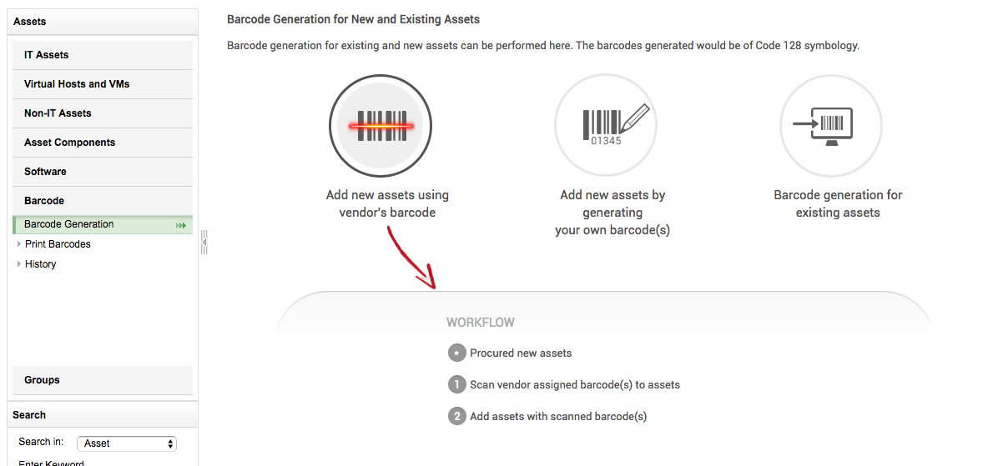
IMPORTING ASSETS
FEATURE: BARCODES SCANNING
The technicians add new assets either by scanning the vendor’s barcode or by generating unique barcodes. They include the existing assets by generating barcodes for them.

Slide 9
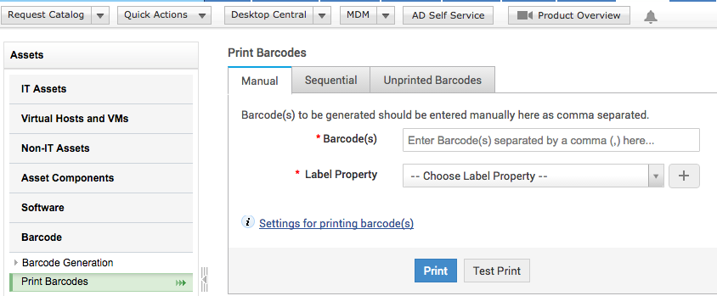
BARCODE GENERATION
FEATURES: PRINT BARCODES
Scott prints out the newly generated barcodes and sticks them to the asset. This makes it easier for future scanning and references.

Slide 10
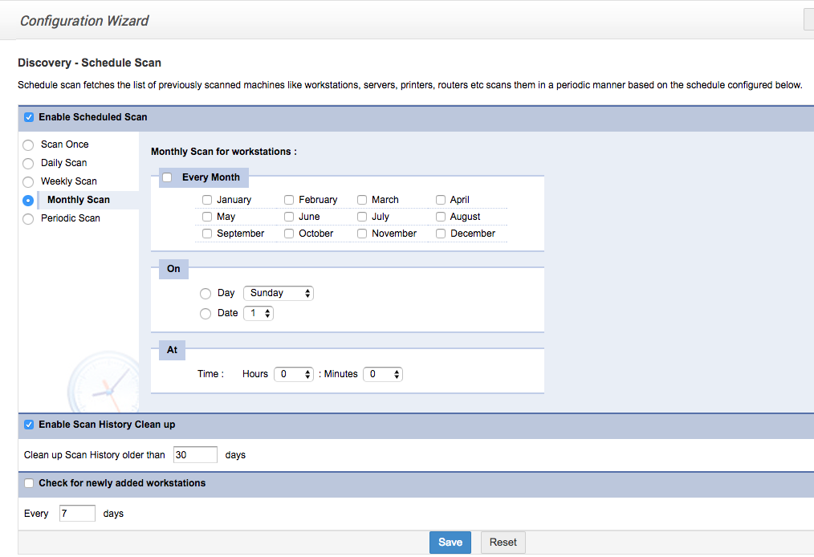
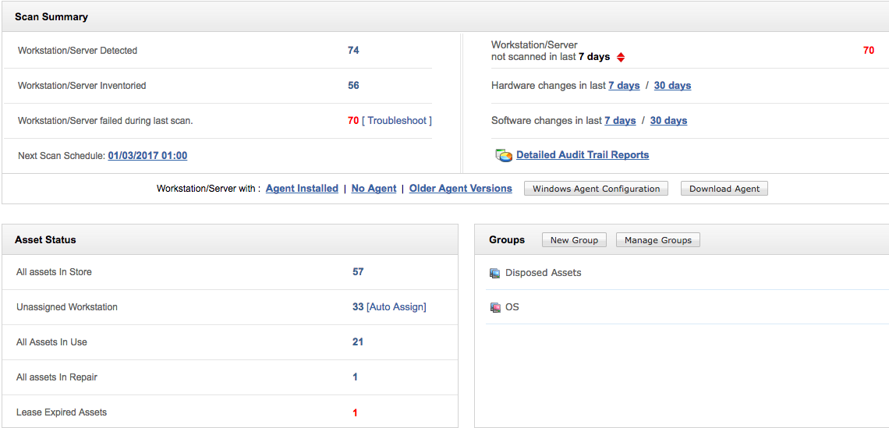
SCHEDULED SCANNING OF ASSETS
FEATURE: SCHEDULED SCAN
Once all the assets are added in the application, Scott configures a scheduled scan. The application will automatically scan all networks and add the new assets to ServiceDesk Plus.

Slide 11
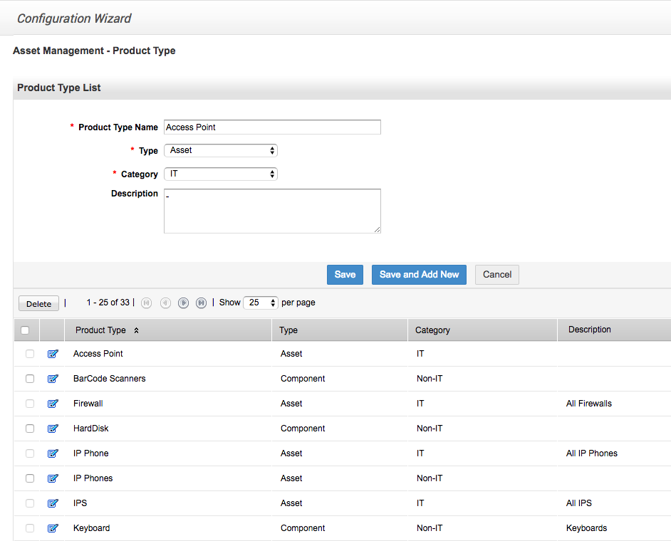
CUSTOMIZING PRODUCT TYPES
FEATURE: PRODUCT TYPES IN ADMIN
Scott creates a list of default product types based on the available assets in Zylker using the ‘product type’ option in the admin module for easy categorization of the added assets.

Slide 12
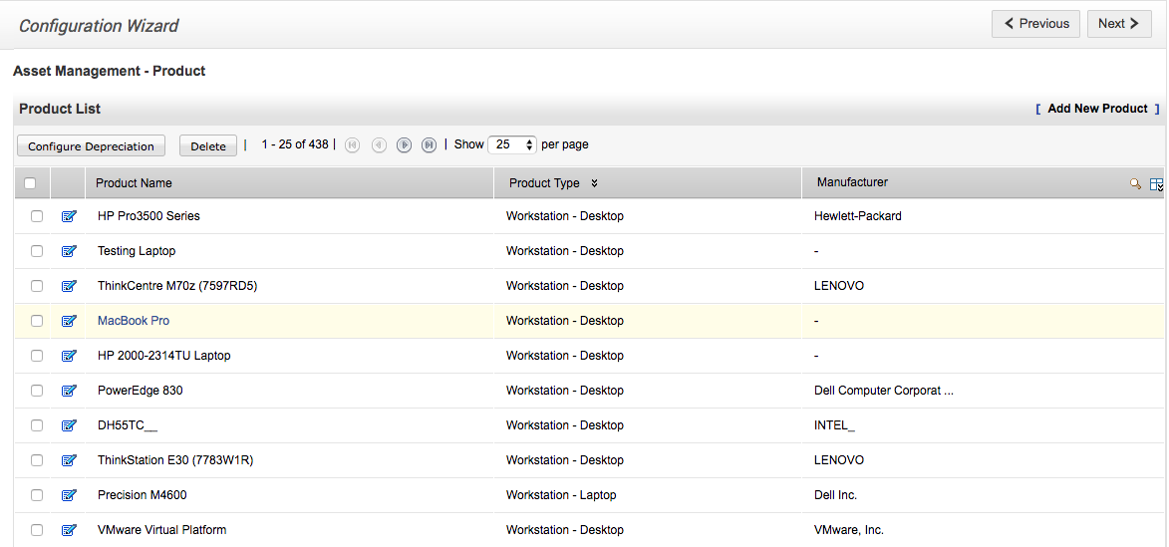
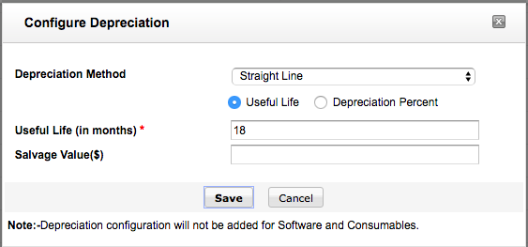
CONFIGURING DEPRECIATION
FEATURE: CONFIGURE DEPRECIATION
Scott adds new products and configures depreciation for each product in ServiceDesk Plus. He can also select multiple products at one time and configure a common depreciation, as applicable. He can choose the depreciation method, and further drilldown and choose between useful life or depreciation percent for each product.

Slide 13
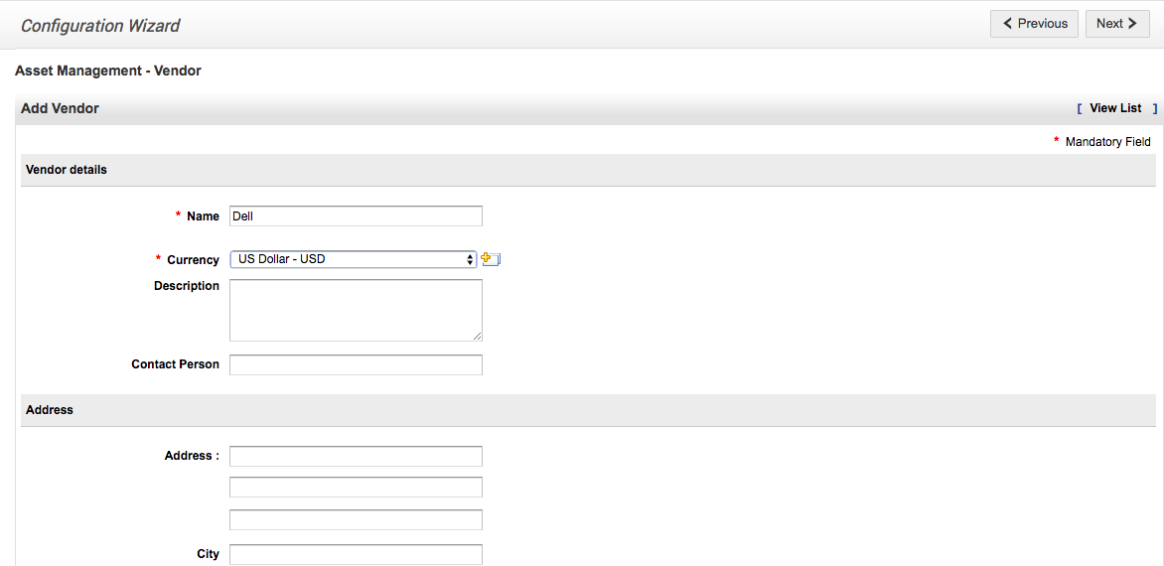
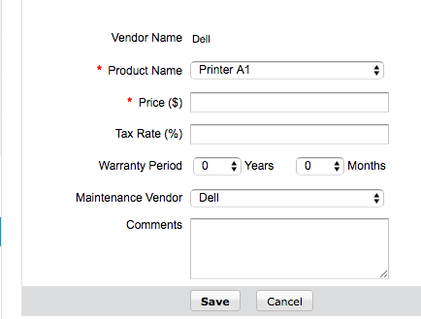
ADDING VENDORS
FEATURE: VENDORS IN ADMIN
Scott adds and associates vendors to the products, wherever applicable, for easy reference in future.

Slide 14
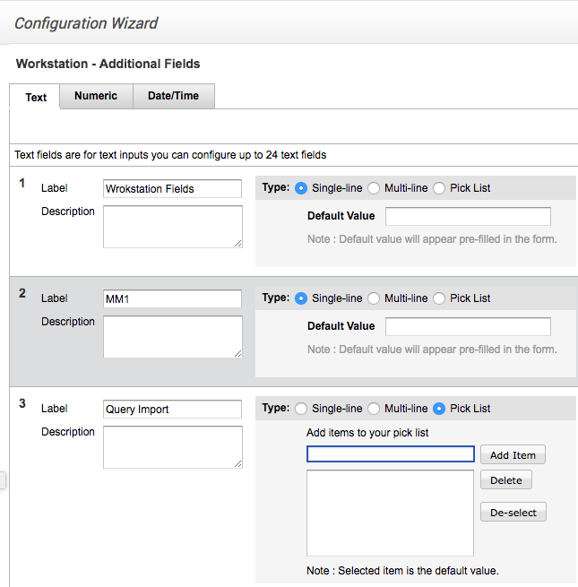
ADDING FIELDS FOR WORKSTATION FORMS
FEATURE: WORKSTATION – ADDITIONAL FIELDS
Scott adds the required fields that need to appear on workstation forms. This helps customize and personalize workstations according to the requirements.

Slide 15
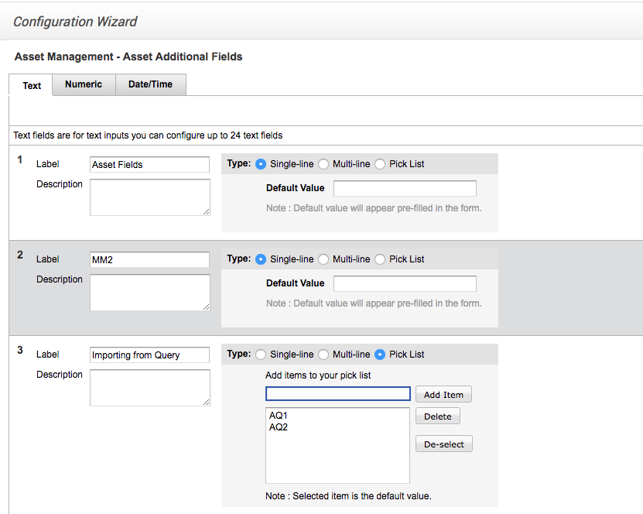
ADDITIONAL FIELDS FOR ASSETS
FEATURE: ASSET ADDITIONAL FIELDS IN THE ADMIN MODULE
Scott adds new fields to reflect on asset forms. The fields can be of text, numeric, or date/time types. This helps add specific description and more details of assets.

Slide 16
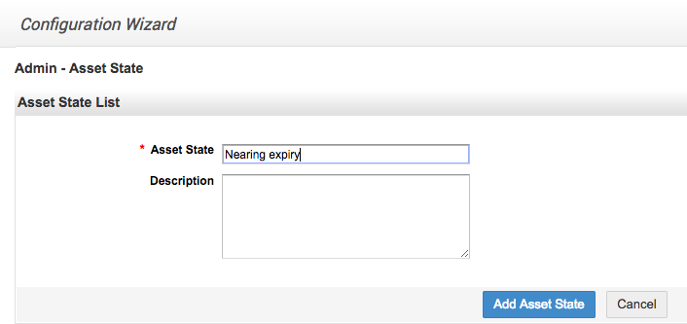
MONITORING ASSETS
FEATURE: ASSET STATE IN THE ADMIN MODULE
Scott adds new asset state description terms in the admin module. This helps track the asset state and promptly replace the assets.

Slide 17
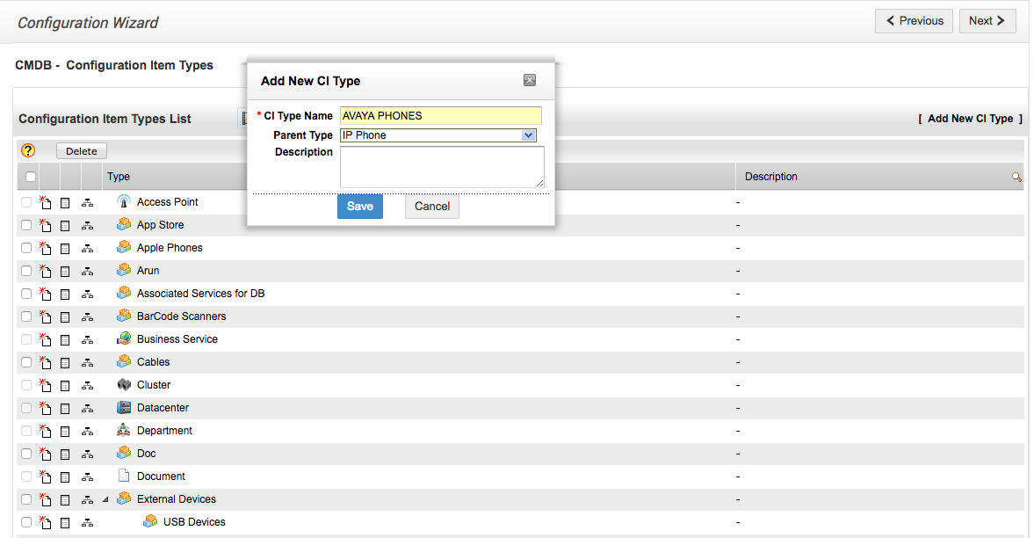
ADDING CI TYPES
FEATURE: CONFIGURATION ITEM TYPES IN THE ADMIN MODULE
Scott adds CI types in the admin module, for better description of assets. Configuration item types help demarcate the kind of asset for better categorizing of hardware assets.

Slide 18
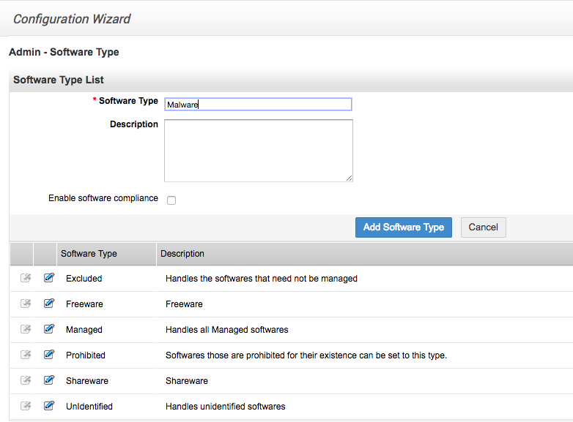
SOFTWARE TYPES
FEATURE: SOFTWARE TYPE IN THE ADMIN MODULE
Scott adds the different types of software along with a relevant description in the admin module.

Slide 19
SOFTWARE LICENSES IMPORT
FEATURE: IMPORT SOFTWARE LICENSES IN THE ADMIN MODULE
Scott imports the available software licenses to ServiceDesk Plus in a CSV file. This will serve as a repository of the available software licenses in the organization.

Slide 20
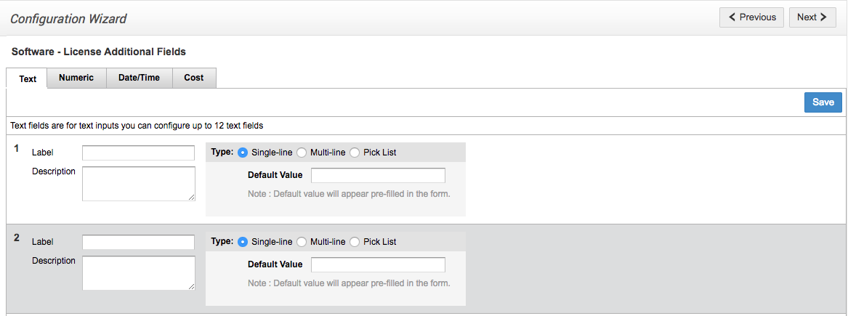
ADDITIONAL FIELDS FOR SOFTWARE LICENSES
FEATURE: SOFTWARE – LICENSE ADDITIONAL FIELDS IN THE ADMIN MODULE
Software licenses are maintained in ServiceDesk Plus. Scott creates additional fields in the admin module which appears on the software license form. Fields can be added as text, numeric, date/time, or cost types.

Slide 21
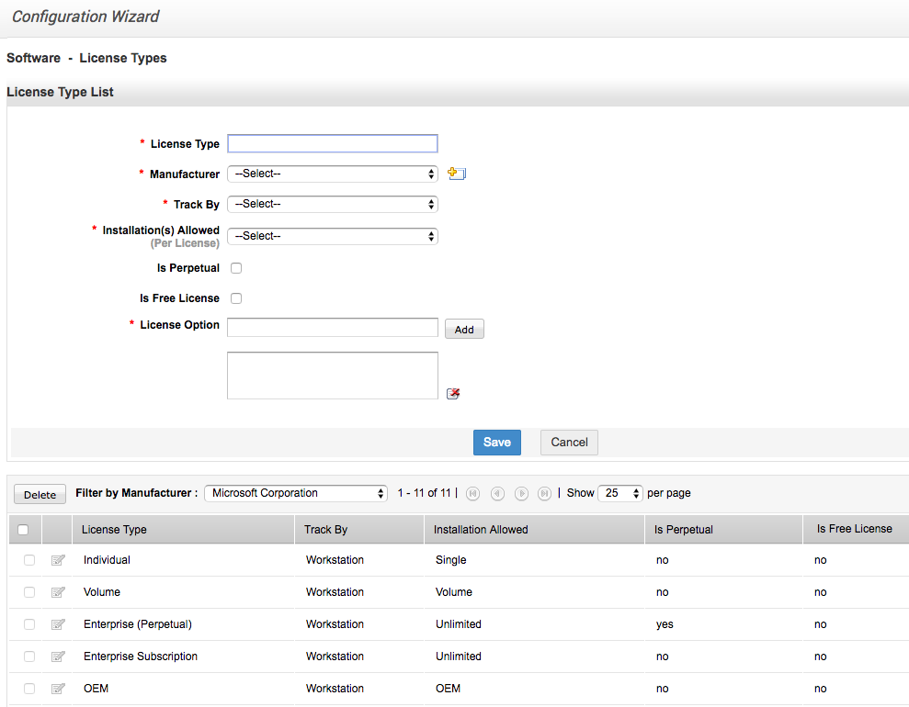
SOFTWARE LICENSE TYPES
FEATURE: SOFTWARE – LICENSE TYPES
Licenses come in different types, ranging from free, monthly, trial, and so on. Scott creates license types in the admin module to categorize the type of software licenses that exist in the organization. He also selects the manufacturer and the workstation it belongs to.

Slide 22
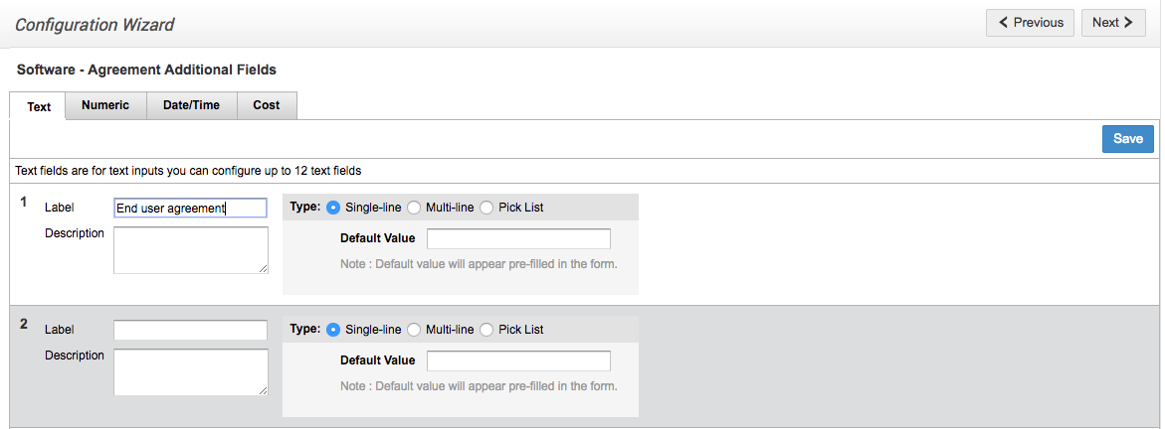
SOFTWARE AGREEMENT ADDITIONAL FIELDS
FEATURES SOFTWARE – AGREEMENT ADDITIONAL FIELDS IN THE ADMIN MODULE
Scott also adds software agreement fields in the admin module. These will help identify the software agreement type by appearing in the asset description.

Slide 23
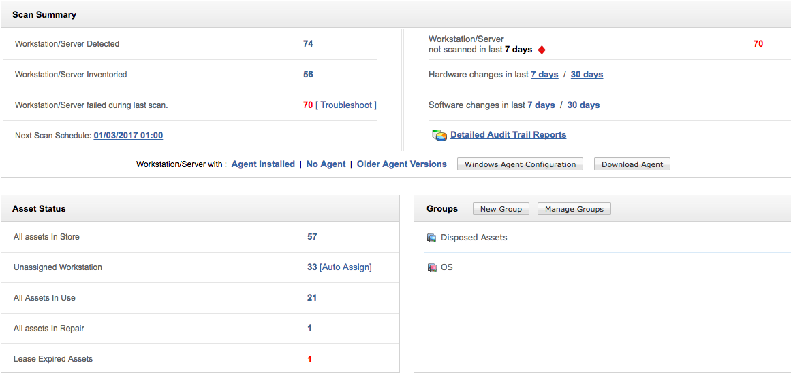
SUMMARY OF ASSETS
FEATURE: DASHBOARD
The dashboard allows the technicians to get a view of the scan summary, the status of assets, and also the associated groups. They can also get a detailed audit trail report or schedule the next scan from the page. This provides visibility and control of the assets.

Slide 24
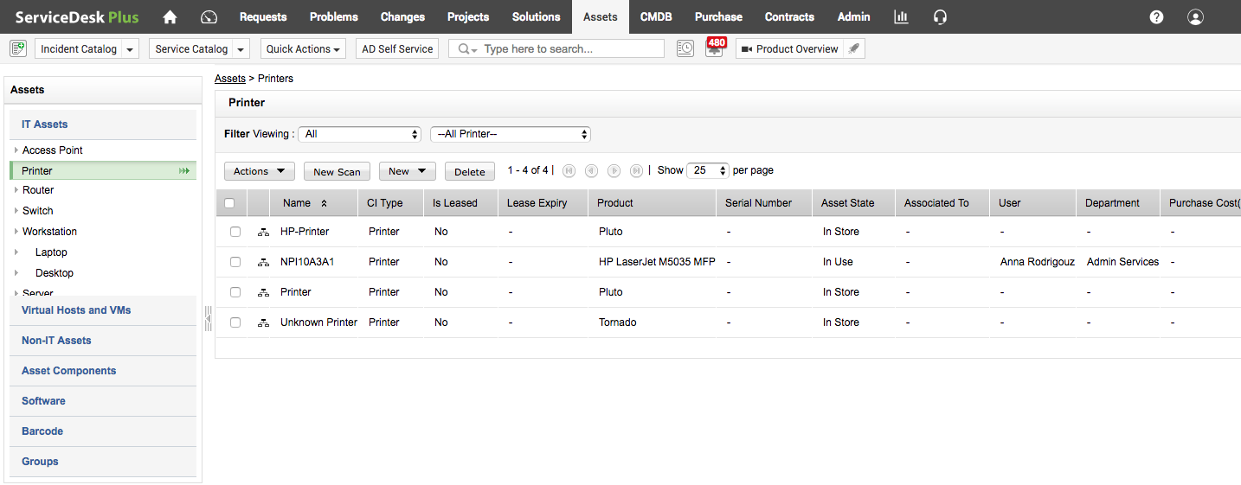
ASSETS OVERVIEW
FEATURE: ASSETS MODULE
Scott can view the list of all the available assets in the application. This helps to have an overview of all the available assets. He can also perform certain actions such as scan the assets, configure depreciation, and more.

Slide 25
ServiceDesk Plus’ 6 step checklist for the best ITAM
BUILD
Build your inventory with multiple discovery sources.
Scan (Windows, network, barcode) and classify
TRACK
Track the complete life cycle of assets.
Asset states.
MANAGE
Manage software and licenses in one place.
Software types, license agreements, license types, and compliance dashboards.
COMBINE
Make ITAM work with other ITIL processes.
CMDB, relationships and attributes.
MONITOR
Keep tab on metrics that matter.
Standard, custom, audit reports and dashboards.
COUNT
Count the costs.
Depreciation, cost center.

Slide 26
What customers say
ServiceDesk Plus has been a great decision both functionally and financially.
James Arnold
Service desk manager
Manhattan Associates

Slide 27
100,000+
IT service desks
700,000
IT technicians
185
Countries worldwide

Slide 28
Get ServiceDesk Plus
Join the 100,000+ IT help desks worldwide.
Sign up for a 30-day free trial.
Have questions? Drop us a line at hello@servicedeskplus.com

