Slide 1

Risk exposure management
Visualize, assess, and mitigate privilege escalation risks in Active Directory

Slide 2

Limited visibility into privileged entities increases security risks
Difficult to identify vulnerable privileged groups and access paths
Manual investigations are time-consuming and error-prone
Attackers exploit privilege escalation paths to gain control
Need for continuous monitoring and proactive risk mitigation

Slide 3




What is the risk exposure management in ADManager Plus?
A visual representation of privileged entity risk exposure in AD environments
Maps potential attack paths that can compromise both built-in and custom privileged groups
Identifies vulnerable groups and associated threat pathways
Delivers a complete assessment of privilege escalation vulnerabilities
Displays actionable remediation measures to strengthen your organization's security framework

Slide 4
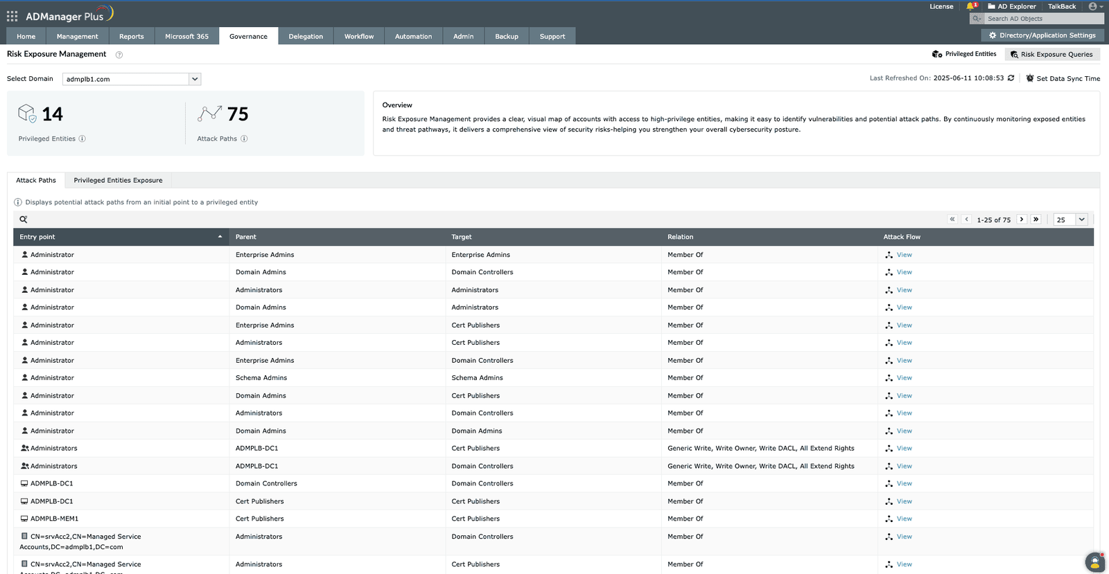
Risk exposure management dashboard
This indicates the identified potential routes an attacker could take to compromise high-value assets within Active Directory.
1
2
1
This highlights all the highly sensitive accounts or groups that, if compromised, could grant an attacker significant control over Active Directory.
2
3
This column provides a detailed breakdown of the specific relationships and permissions constituting each attack path, visible by clicking "View."
3
Text

Slide 5




Visual attack path mapping
Privileged group exposure
Scheduled data
update
Privilege queries
library
Graphical representation of paths attackers might use to gain access to privileged groups. This shows how attackers might reach privileged targets
Identifies built-in and custom groups at risk by mapping potential attack pathways. This shows which privileged targets are exposed and how they are vulnerable
Keeps the data up to date for proactive management
Pre-built queries for detailed risk insights

Slide 6



What is the risk exposure management in ADManager Plus?
Map attack paths
Identify privileged targets
Analyze relationships and permissions
Visually identify potential routes an attacker could take from entry points to compromise high-value assets within Active Directory.
Highlight all highly sensitive groups that, if compromised, could grant an attacker significant control over Active Directory.
View a detailed breakdown of the specific relationships and permissions that constitute each attack path.

Slide 7
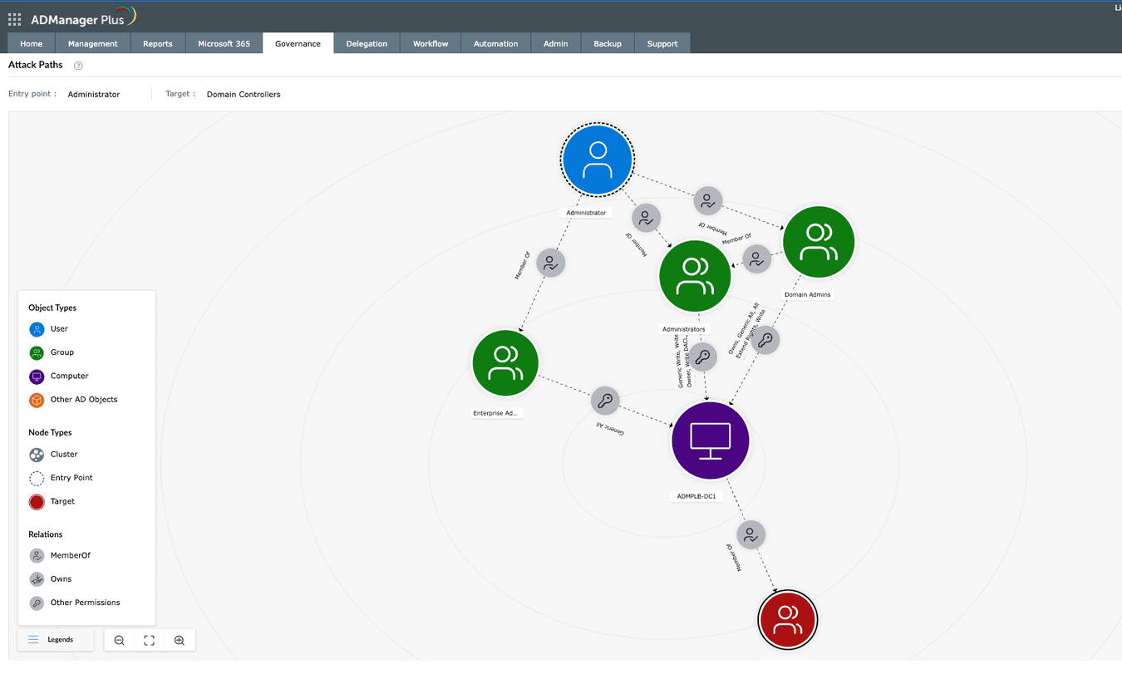
Visualizing Active Directory attack paths
This icon represents the initial point of access or compromise an attacker could leverage, such as a user account.
1
1
This icon signifies the high-value asset or system an attacker aims to reach or control, in this case, "Domain Controllers."
2
3
The arrows and accompanying text (e.g., "Member Of," "Administrators," "GenericAll") depict the specific relationships and permissions that enable the attack path, illustrating privilege escalation or lateral movement.
3
2
Text
Text

Slide 8



Privileged group exposure
Identifying privileged
groups
Mapping attack paths to privileged access
Visualizing risk—the attack flow
Lists critical privileged groups (e.g., Domain Admins, Enterprise Admins, Schema Admins)
Details their OU and domain names for precise location
Shows all accounts and assets that form a path leading to these high-value groups
Clearly identifies the initial point of compromise or the most vulnerable entry point in each attack path
Lists critical privileged groups (e.g., Domain Admins, Enterprise Admins, Schema Admins)
Details their OU and domain names for precise location

Slide 9

View all privileged entities that can be exploited from a single entry point
Navigate through AD Explorer to analyze specific users aspotential attack starting points
Access detailed entitlements and privilege escalation pathsfrom any selected user
Interactive exploration of attack pathways from entrypoint to privileged targets
Click-through analysis of intermediary objects and theirrole in attack chains
Detailed relationship mapping showing how permissionsconnect entry points to privileged access
Built-in remediation guidance for each identifiedvulnerability path
Entry point analysis with access graph
Comprehensive entry point assessment

Slide 10
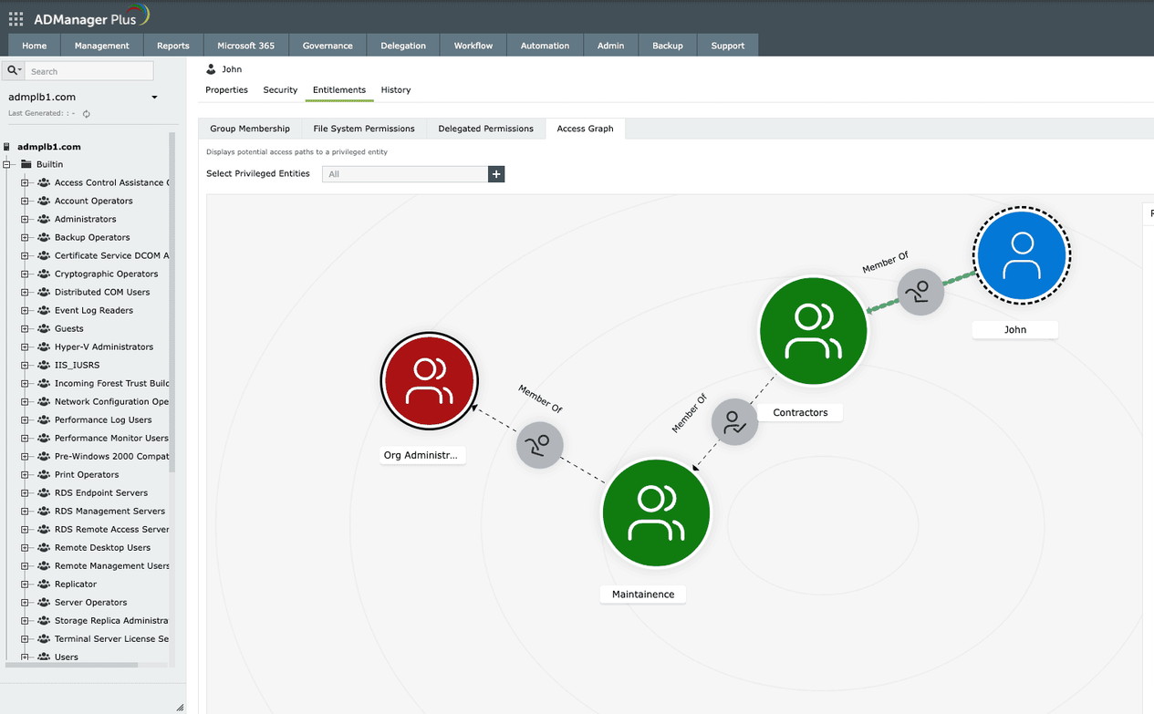
Visualizing Active Directory attack paths
Visually highlights a highly privileged or sensitive Active Directory group, indicating a critical potential target for attackers.
1
1
2
The selected identity (user, group, or computer) for whom the access path and potential risk exposure are being analyzed.
2
2
1
3
Text

Slide 11




Relations, permissions, and remediation measures
Access relationship mapping
Visualize complex, permissions-based connections between Active Directory entities that can be leveraged for privilege escalation or lateral movement.
Uncover attack paths
Select any user or group node to investigate their permissions, scope, and role in potential attack chains.
Identify critical exposure
Analyze how seemingly minor permissions contribute to significant security risks and critical exposure paths.
Actionable remediation
Get specific recommendations to reduce exposure by modifying or removing excessive permissions, enabling prioritized remediation based on risk impact.

Slide 12

Risk exposure queries
Find all members of the Domain Admins group
Map domain trust relationships
Identify Kerberoastable members of high-value groups
Locate principals with DCSync rights
Trace paths from domain users to high-value targets
And more
Provides a library of expert-designed, pre-built queries for rapid identification of common security vulnerabilities

Slide 13
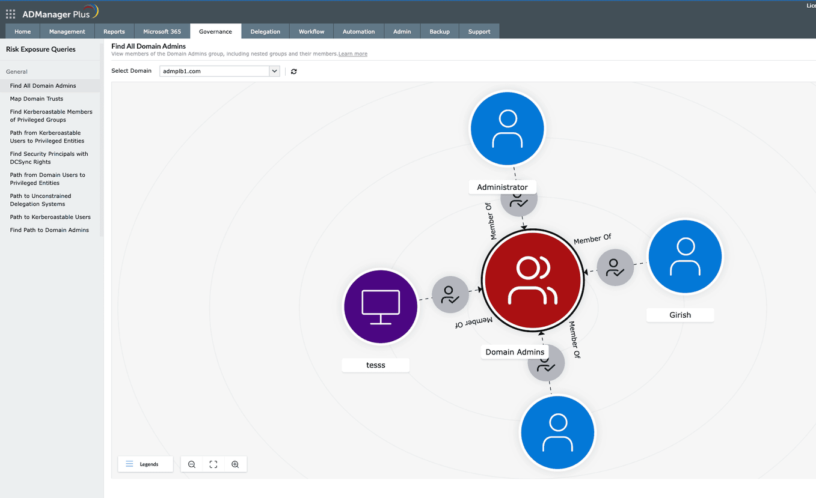
Risk exposure queries library
This central red node highlights the highly privileged 'Domain Admins' group, a critical target for attackers, and shows its members at a glance.
1
1
The Risk Exposure Queries panel provides pre-built reports to instantly identify specific high-risk configurations and vulnerabilities, such as unconstrained delegations or hidden admin accounts."
1
2
2
2
3
Text

Slide 14
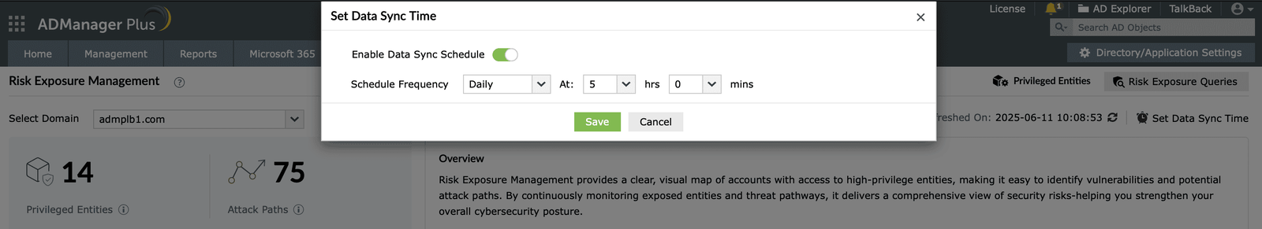



Continuous monitoring and reporting
Schedule periodic update of the data
Real-time updates on privileged group exposures and attack paths
Enable security teams to prioritize vulnerabilities and take timely action

Slide 15
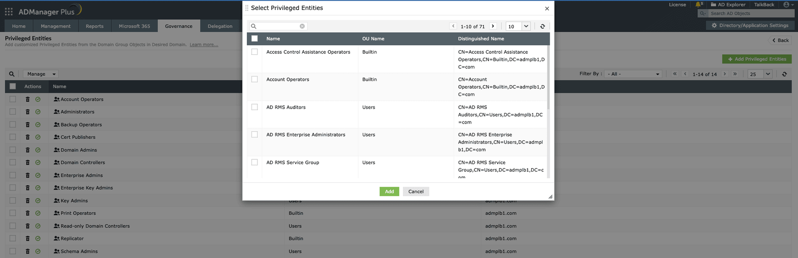
Managing privileged Active Directory entities
This showcases ADManager Plus's Privileged Entities management feature, demonstrating how to view existing privileged accounts and the process of adding new ones to monitor and manage their security within the domain.

Slide 16





What you gain with risk exposure management
Proactively uncover and reduce privilege escalation risks
Improve AD security posture with visual, easy-to-understand data
Identify security risks and take immediate action to reduce them
Keep an eye on high-value groups in your AD
Add custom groups to the list of built-in privileged AD groups and monitor access paths to them for potential attacks

Slide 17
Explore risk exposure management
Start proactively protecting your AD today!

